Slide 1
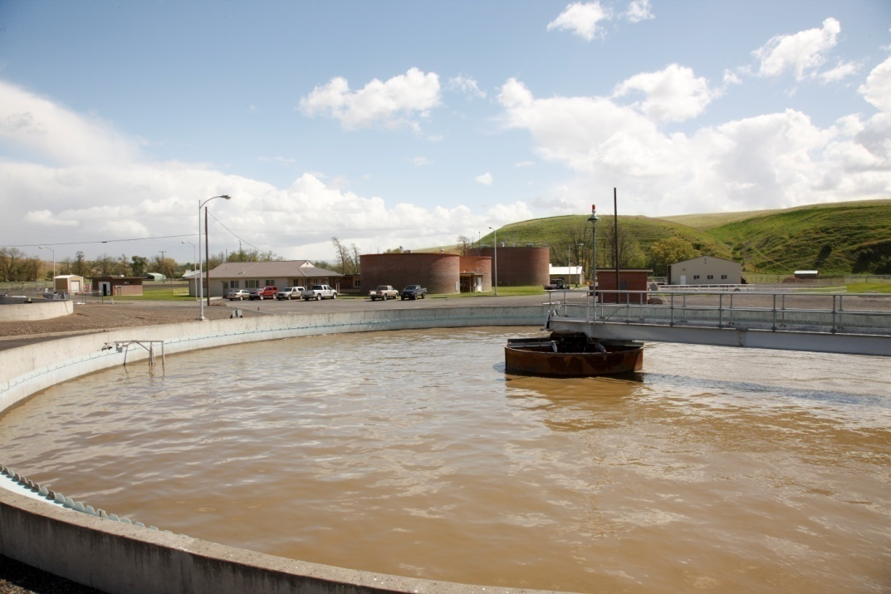
Tools to Control Energy Use through O&M Practices
Wastewater/Water Sustainable Energy Cohort, October 11, 2012
Presentation by Walt Mintkeski, P.E.

Slide 2
Why do we need Tools?
To achieve energy savings, equipment must be maintained & operated efficiently
Law of Entropy: Systems change & drift from peak efficiency point due to changes in plant inputs, equipment wear & tear, instrument calibration drift, etc.
Persistent practices are needed to maintain & improve energy efficient operation because human behavior is difficult to change

Slide 3
Tools for Operating Systems Efficiently
Vigilance: routine inspections
PM: Preventative Maintenance
SOP’s: Standard Operating Procedures
Procurement Policies
SCADA Systems
Plan, Do, Check Process

Slide 4
Vigilance: look & listen for items on O&M Checklist
During Daily Rounds & Periodic Safety Team & Energy Team Inspections:
Look for air, water, pump packing leaks
Look for aeration basin air boils
Look for excessive vibration, throttling
Listen for excessive noise
Notice what equipment is operating. Is it needed?

Slide 5
Preventative Maintenance
Schedule & perform proactive intervention measures to keep equipment at peak efficiency:
Change filters
Clean & calibrate pressure gages, flow meters, DO probes
Clean diffusers, UV tubes, % UV transmittance meter
Check and replace pump wear rings, bearings
Use a maintenance scheduling program or Master Calendar

Slide 6
SOP’s: develop criteria & procedures to achieve desired effluent quality with minimum energy use (Three line instructions)
Take off line extra clarifiers, aeration basins, blowers, disinfection equipment
Minimize pumping rates: RAS, WAS, AB return
Minimize DO levels in Aeration Basins
Turn off Blowers periodically
Raise influent levels in pump wet wells
Measure pressure drop across filters & diffusers

Slide 7
Procurement Policies
Consultant Services: require energy efficiency experience and request example projects
Review consultant designs: question over-design vs. design for average conditions
Develop equipment specifications which incorporate energy efficiency requirements:
Minimum efficiencies for pumps & blowers
Motor sizing for minimum 75% loading
Light bulbs & other replaceable items

Slide 8
SCADA Systems: Supervisory Control & Data Acquisition
Supervisory Control of systems - tune controls so that they perform desired function & so that manual overrides are not necessary
Data Acquisition - program to gather data needed to observe trends & to alarm for abnormal conditions:
GPM/kW for pumps & CFM/kW for blowers
kWh/ million gallons treated
DO trending in Aeration Basins
Alarm for two identical pumps running
Alarm for excessive plant water use

Slide 9
Plan, Do, Check Process in O&M
Energy Team - Plan energy efficient O&M measures, implement, evaluate after designated time period, and revise if necessary
Maintenance Group - develop PM practices for trouble free & energy efficient equipment operation
Operations Group - develop process SOP’s to achieve desired effluent quality with minimum energy use: Aeration, Mixing, Pumping Systems
Turning down blower & mixer equipment
Annually testing blowers & pumps to select most efficient equipment to operate

Slide 10
Questions, Comments, & Small Group Work
Questions?
What other Tools and/or Systems are available to assure that desired practices to Control Energy Use will be followed? (brainstorm ideas)

Slide 11
Small Group Work
Select one or two highest priority O&M energy efficiency measures from your Opportunities Register
Outline controls for these measures using tools presented above and other tools or systems available to you
Report out in 10 minutes

Slide 12
Tools for Operating Systems Efficiently
Vigilance: routine inspections
PM: Preventative Maintenance
SOP’s: Standard Operating Procedures
Procurement Policies
SCADA Systems
Plan, Do, Check Process

