Slide 1
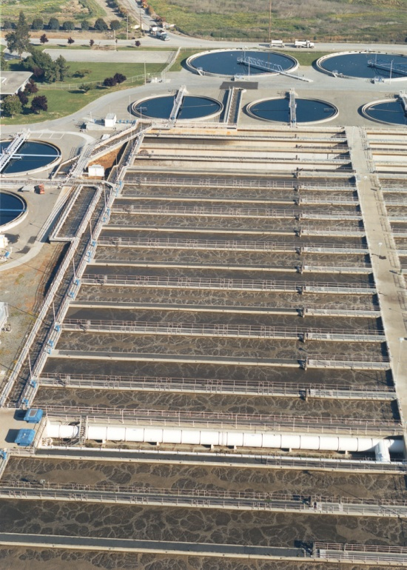
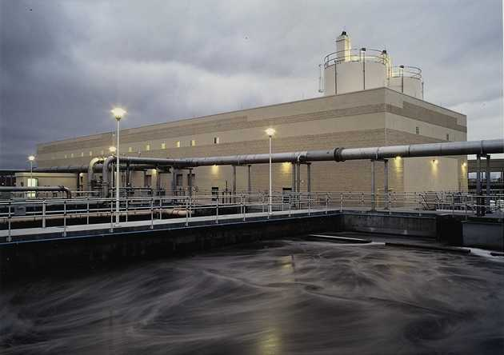
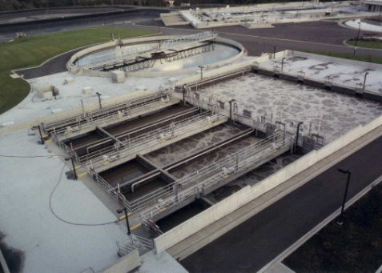
Aeration System Opportunities
Aeration System Opportunities
WW/W Sustainable Energy Cohort-Session 5
January 31, 2013
Dave Reardon, PE, ENV SP HDR National Director - Water Sustainability

Slide 2
All Set for an Hour Discussion of Fine Bubble Diffusers, Turbo Blowers, and Dissolved Oxygen (DO) Control?
Too Bad…
You Will Be Disappointed

Slide 3
Presentation Agenda
Loading to Aeration Basin
Blowers
Impacts of SRT and Selectors
Blower Pressure, Ammonia Control, and ML Recycle
Sidestream Treatment
Overdesign
Take Away Points

Slide 4
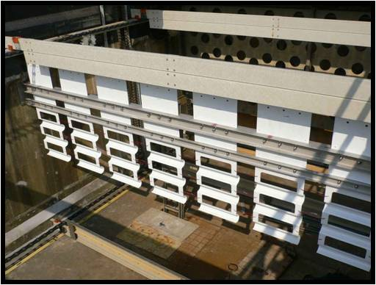
Improving Primary Clarifier Performance Can Make A Difference
Improved hydraulics and baffling can increase suspended solids (SS) removal by 10%
SS = BOD = Energy in activated sludge process
What Would Happen if We Removed 95% of SS Prior to Aeration?

Slide 5
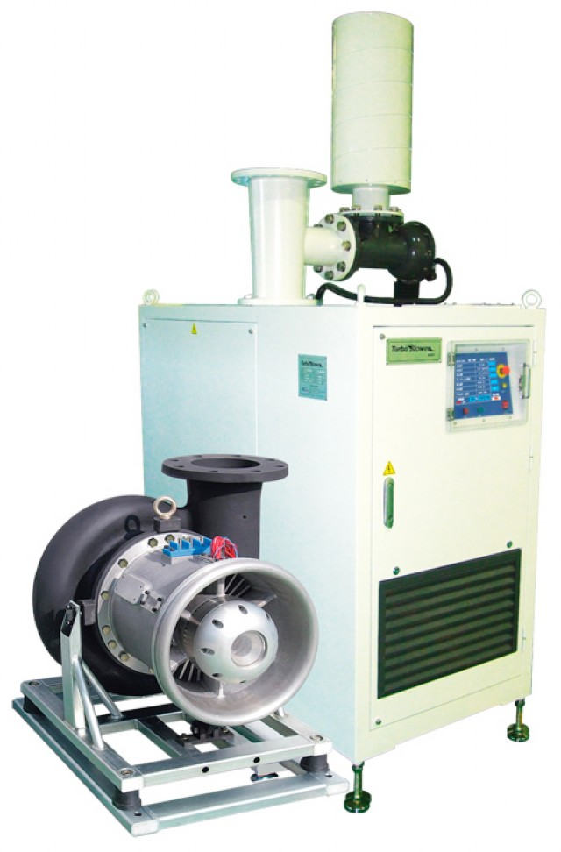
Much Has Been Said About Turbo Blowers

Slide 6
Blower Selection and Sizing is Critical
Single-Stage Dual-Point Control and High-Speed Turbo Blowers
80
70
IGV Single-Stage
Multi-Stage
Isentropic Efficiency (%)
60
Positive Displacement with VFD
50
40
50
60
70
80
90
100
Capacity (%)

Slide 7
Make Alpha Work for You, Not Against You in Heavily Loaded Section of Aeration Basin
Tank Length (feet)
0
50
100
150
200
250
0.6
Process with Anoxic Selector
0.5
Anoxic Selector (α not defined)
α
0.4
0.3
Conventional Process
0.2
0
20
40
60
80
100
Tank Length (%)
Energy Saving Benefits of Denitrification - Rosso and Stenstrom (2007)
Mechanical Aeration or Coarse Bubble Have Better Transfer Efficiency?

Slide 8
Impact of MCRT on Oxygen Transfer
Tank Length (feet)
0
250
500
750
1,000
20.0
Nitrifying MCRT > 10 days
Field Oxygen Transfer Efficiency (Fouled Diffusers)
16.0
12.0
8.0
Conventional MCRT ~ 2 days
4.0
0
100
200
300
Tank Length (m)
Rosso and Stenstrom (2007)

Slide 9
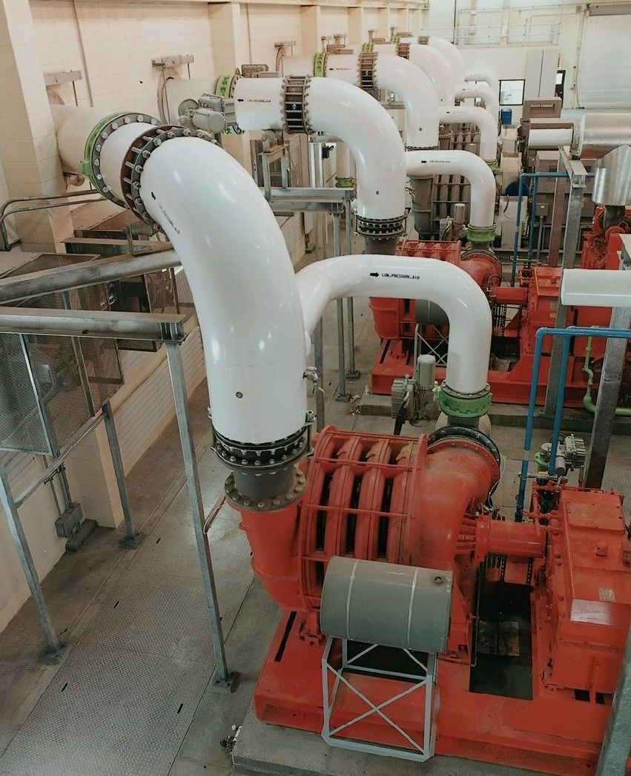
What About Blower Header Operating Pressures?

Slide 10
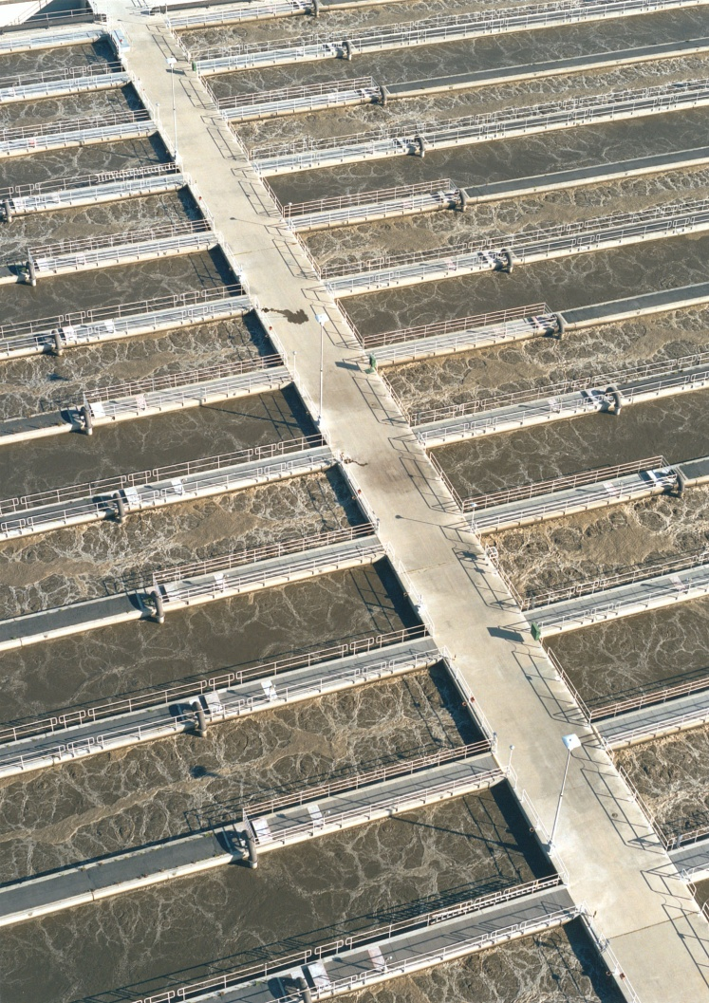
Modification of Dissolved Oxygen (DO) Control System to Include Ammonia Control
Blower Energy Reduction of 5 to 10% May Be Possible

Slide 11
Configuration of Aeration Basins Can Reduce Mixed Liquor Recycle Energy
Primary Effluent
Primary Effluent
Aeration Basin
Mixed Liquor Recycle
Mixed Liquor Recycle
Single Pass
“Folded” Basin
75% Reduction in Mixed Liquor Recycle Energy and Less Equipment

Slide 12
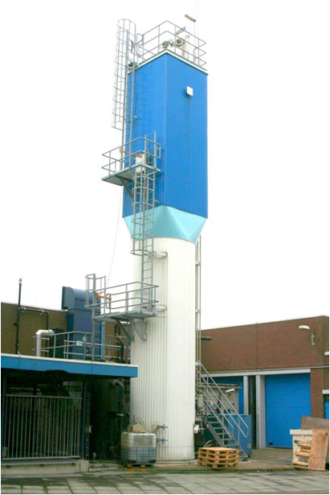
Side Stream Treatment (Digester Centrate or Filtrate) Has Energy Advantages
Sidestreams are a high source of ammonia
100% reduction in carbon source required
Small footprint
50% reduction in energy
Anammox Tower

Slide 13
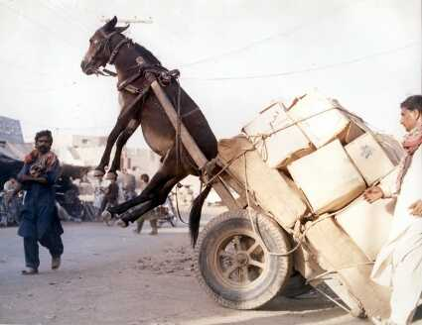
Right Sizing and Proper Selection of Equipment Produces Large Energy Savings

Slide 14
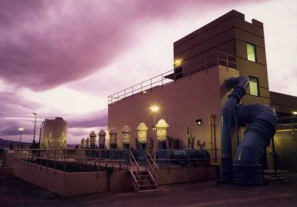
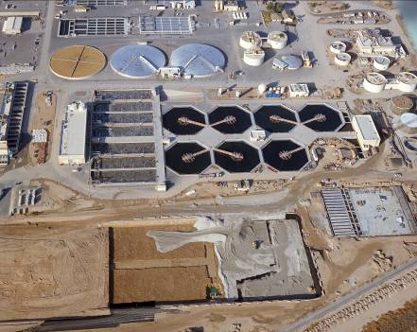
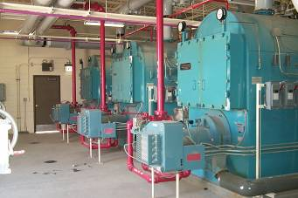
We Don’t Need to Optimize Energy … We Have a Brand New Plant!

Slide 15
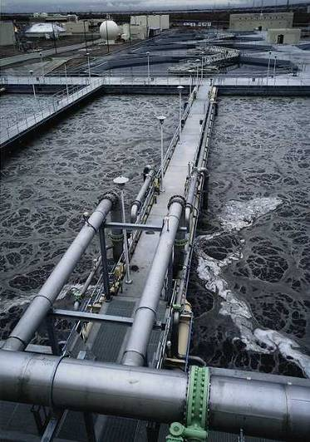
You Have Just Been Asked to Design an Activated Sludge Aeration System

Slide 16
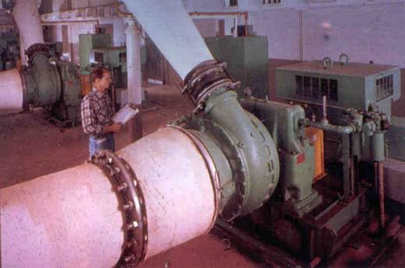
Where is the Energy? Blowers!!

Slide 17
Peaking Factors for Overdesigned Blower Systems
Avg Condition
Worst Case
Peak Factor
Yearly: Peak Day versus Average Day BOD
1.00
1.20
1.20
Diffuser Alpha (a)
0.55
0.39
1.40
Peak Day versus Average Day Ammonia
1.00
1.30
1.15
Diurnal: Maximum Hour versus Average BOD
1.00
2.00
2.00
Design Year 2025 versus current Loads
1.00
1.34
1.34
Ten States Standards versus Actual BOD Data
1.00
1.10
1.10
This doesn’t even include the safety factor for temperature!

Slide 18
What’s the Bottom Line?
A total safety (or peaking) factor of 5.7!

Slide 19
Blower Design Conditions
Average Flow Conditions Now
5,000 cfm Air Flow
Worst Case Future
28,500 cfm

Slide 20
Three-Blower Installation Will Require 14,250 cfm Blowers
Blower No. 1
Blower No. 2
Standby Blower
14,250 cfm
14,250 cfm
14,250 cfm
28,500 cfm

Slide 21
Multi-Stage Blower Has Surge Point at Approximately 50-60 Percent of Design Capacity
12
Surge: 7,100 cfm
10
Discharge Pressure (psi)
8
6
Design: 14,250 cfm at 8 psi
4
2
0
0
5,000
10,000
Flow (cfm)
15,000

Slide 22
Unit Power Consumption on Multi-Stage Centrifugal Blowers Increases at Throttled Conditions
70
60
50
HP/1,000 cfm
40
Constant Discharge Pressure
30
20
10
0
40
70
100
Percent of Design Flow

Slide 23
Blower Power Consumption
250

68⁰ F, 36⁰ RH, 5000 SCFM Blower

200

■
HP
Multi-Stage, Inlet Throttling

150
Multi-Stage VFD

■

100
High Speed Turbo Blower
■
Single Stage, Inlet Guide Vanes, Outlet Diffusion Vanes
■
25
50
75
100
Percent of Design Flow

Slide 24
What Should You Do?
Blower No. 1
Blower No. 2
Blower No. 3
Blower No. 4
8,000 cfm
8,000 cfm
14,250 cfm
14,250 cfm
OR
Blower No. 1
Blower No. 2
Blower No. 3
Blower No. 4
8,000 cfm
14,250 cfm
14,250 cfm
14,250 cfm

Slide 25
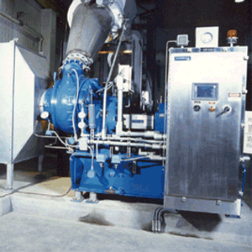
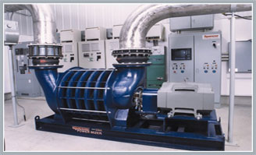
It’s Becoming Quite Fashionable to Combine Blower Types
8,000 cfm
8,000 cfm
14,250 cfm
14,250 cfm
Two Single-Stage
Two Multi-Stage

Slide 26
Channel Aeration Overdesign is Common
5 cfm/foot channel

Slide 27
Don’t Scrimp on Adding Equipment that Will Optimize Energy at Average Conditions
$2.3 Million
$100,000
250 hp Blower Capital Cost
Energy (20 years)

Slide 28
Your Overdesign Repellant
Equipment operates at “worst case” conditions < 5 percent of the time
Most designs are specified to be efficient at worst case conditions
Equipment is often unstable, inefficient at average/minimum conditions

Slide 29
Your Overdesign Repellant (cont’d)
Use “jockey” pumps, blowers for minimum, average conditions
Kick your consultant in the behind! Ask about operation without all the safety factors

Slide 30
Your Take Away Points
Efficient aeration design is much more than blowers and fine bubble diffusers
Reduced loading on aeration basins
Conduct sustainability reviews of aeration systems and other processes
Overdesign must be avoided
Challenge Your Consultants!

Slide 31
Aeration System Opportunities
Aeration System Opportunities
Dave Reardon, PE, ENV SP HDR National Director - Water Sustainability
(916) 817-4820 Dave.Reardon@hdrinc.com

