Slide 1

WSU Energy Program
Your regionally, nationally and internationally recognized energy experts
  Washington State Presents:
  Adventures in
  Alt Fuel/Vehicle Policy
  Jim Jensen
Senior Bioenergy and Alternative Fuels Specialist
  Washington State University Energy Program
360-956-2083
jensenj@energy.wsu.edu
  February 2014

Slide 2

Prelude
Hybrids

Slide 3
Washington Chooses Hybrids
Executive Order 05-01 (2005):
Established sustainability and efficiency goals
Vehicles: froze purchase of 4WD SUVs unless they meet 30 mpg standard
  Priority given to hybrid electric vehicles (EPACT standards notwithstanding)
  Accelerated replacement of older vehicles
  State motor pool reached 50% hybrids (claim: 1st among states)
  “Sustainability” means meeting the needs of current generations without impairing the ability of future generations to meet their own needs

Slide 4
Act I
Biofuels

Slide 5
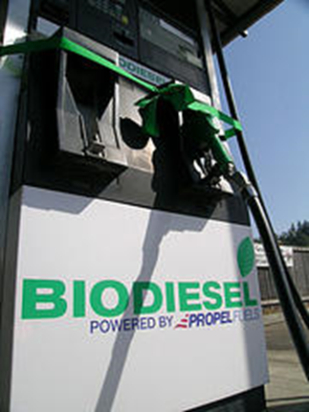
Washington Biofuel Initiatives
Goals (2006-07):
Reduce dependence on foreign oil
Safeguard environment and public health
Stimulate economic development, especially for rural communities
Strategies:
  Provide tax and other incentives to encourage investment in production & distribution facilities
  Invest in cropping systems research
  Direct state agencies to lead the way in use, ensure biofuel quality

Slide 6
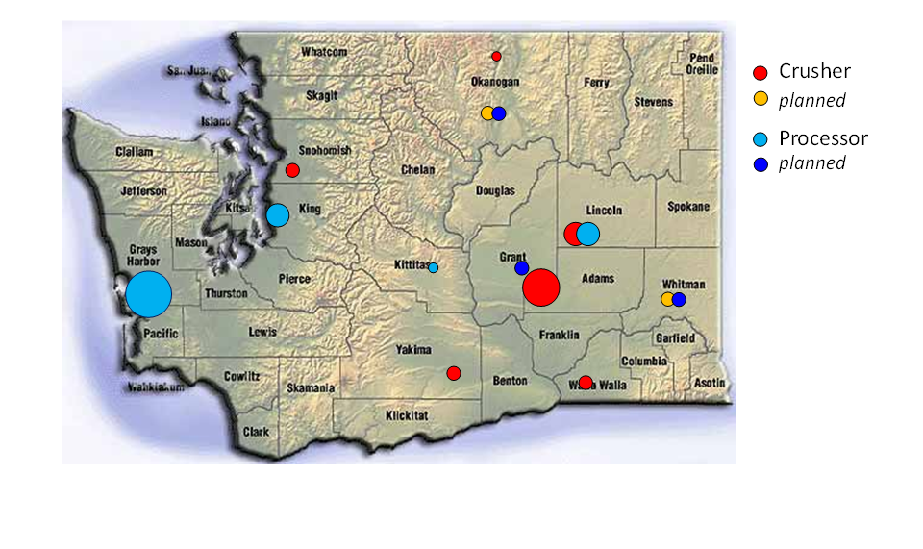
Washington Biodiesel Production
Crush capacity = 350,000 T/yr
Refining capacity = 109 MGY

Slide 7
Research Initiatives at WSU
Diversify Washington agriculture
Bioenergy crop research (13 varieties, 4 regions)
Oilseed crush co-products (bio-pesticide, soil amendment)

Slide 8
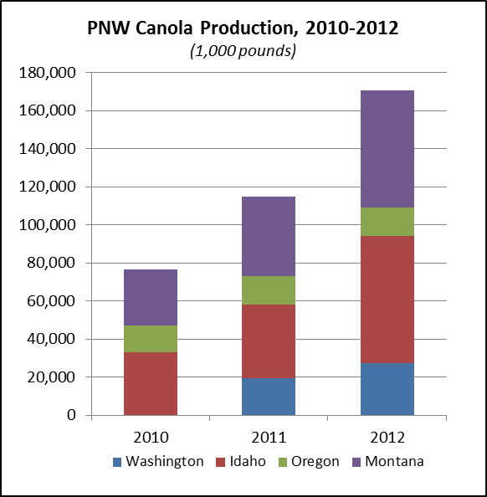
WSU Crop System Case Studies
Stand establishment, winter survival, herbicide carryover solutions
Increased crop and oil yield
Site-specific varieties
Planting date, basic agronomics of oilseed crops
Optimal irrigation and fertilizer timing
http://css.wsu.edu/biofuels/
NASS, Crop Production Annual Summary, Jan 11, 2013
Note: Washington not published separately in 2010

Slide 9
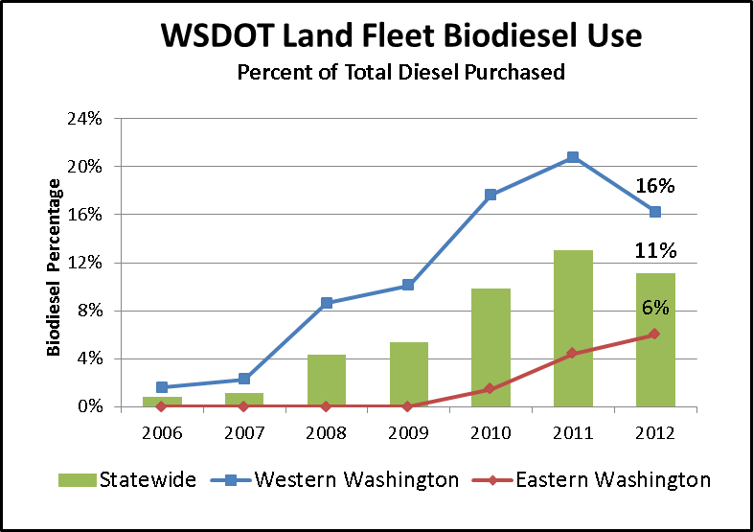
State Agency Biodiesel Use
Contracts call for at least 51% in-state biodiesel
State Ferries: purchases to increase in 2013 and 2014
Land Fleet: Blends above B20 suspended in May 2012 for materials compatibility review.

Slide 10
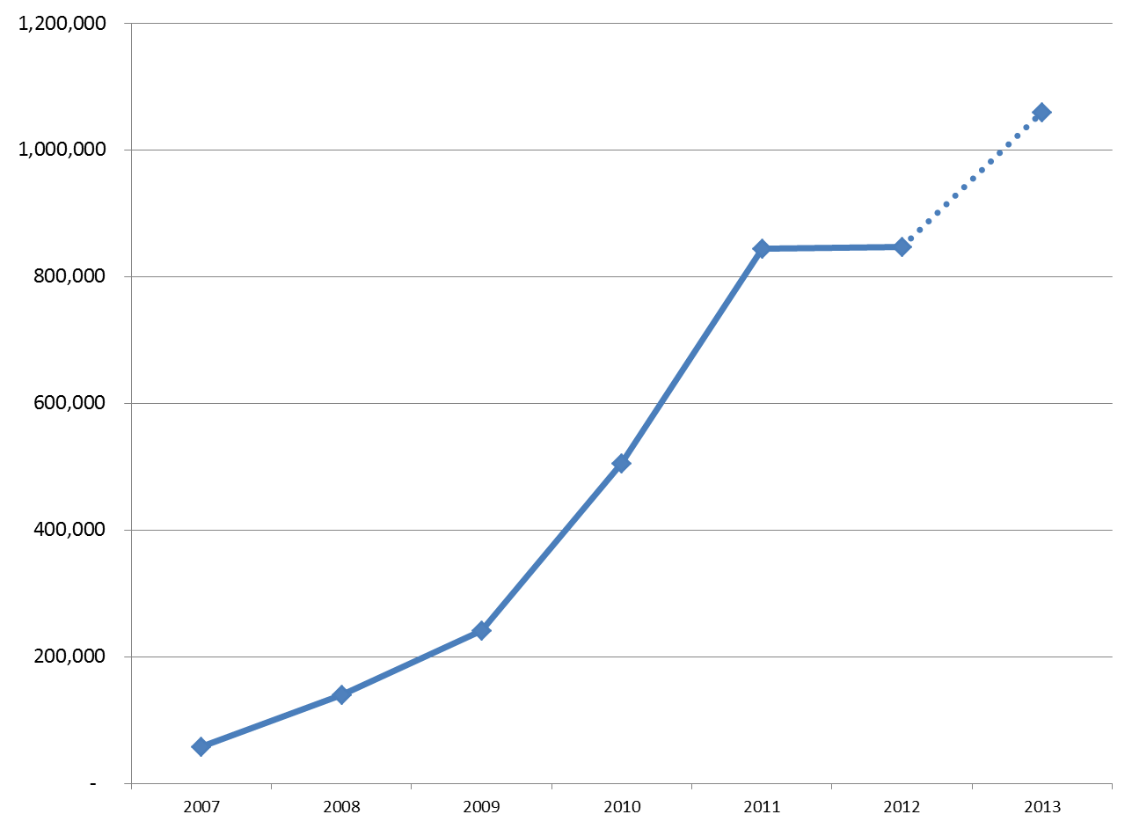
Total State Biodiesel Use

Slide 11
Act II
Aviation
Biofuels

Slide 12
Washington Aviation Biofuel Initiatives
SAFN (Sustainable Aviation Fuels Northwest)
  Launched in 2010 by Boeing, Alaska Airlines, Port of Seattle, Port of Portland, Spokane Intl Airport, WSU, Climate Solutions and 40 other stakeholders
  Established the requirement for “drop in” biofuels
  Other factors: sustainability, commercial scale, and economic viability
Aviation Biofuel Study Group and Innovate Washington got the legislative mission to continue developments
800 million gallons per year

Slide 13
Aviation Biofuel Research
NARA (Northwest Advanced Renewables Alliance):
  $40 million for forest residuals research
  WSU leads the project
  www.nararenewables.org
AHB (Advanced Hardwood Biofuels):
  $40 million for research about purpose-grown poplars
  UW leads this project
  www.hardwoodbiofuels.org
Northwest Wood-Based Biofuels + Co-Products Conference
April 28-30, Seattle, WA

Slide 14
Act III
Electrification

Slide 15
An Act Relating to Electric Vehicles
HB 1481, passed by the Legislature in 2009
Directions to develop a model ordinance and guidance document for charging infrastructure
Directions to local governments to revise development regulations
Directions to revise, as appropriate, the state building and electrical codes
Sales tax exemptions for electric vehicles and charging infrastructure (sunset 2015)
Support for WSDOT alternative fuels corridor

Slide 16
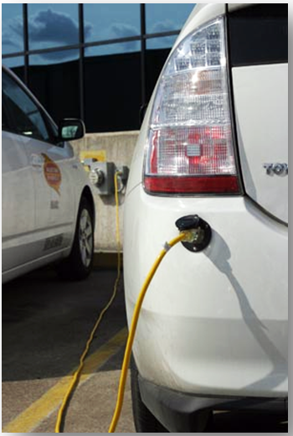
More Steps
An Act Relating to Electric Vehicle Battery Charging Facilities (HB 1571) - passed in 2011 to limit regulation of EVSE
  Keeps Utilities and Transportation Commission from regulating rates, services, facilities, and practices of facilities offering EVSE (unless otherwise regulated by UTC)
Electrical charging in state’s fleet parking and maintenance facilities by December 31, 2015 “to the extent practicable.” RCW 43.19.648

Slide 17
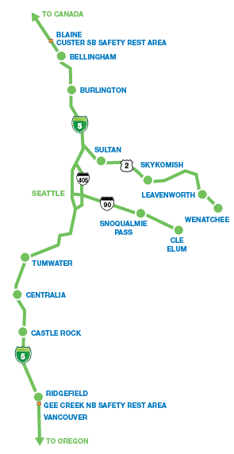
Washington’s Electric Highways
Multiple locations of Level 2 and DC Fast service
Aerovironment EVSE
West Coast Electric Highway (I-5 corridor)
Stevens Pass Green Byway (Highway 2)
Expanding along I-90 toward the east

Slide 18
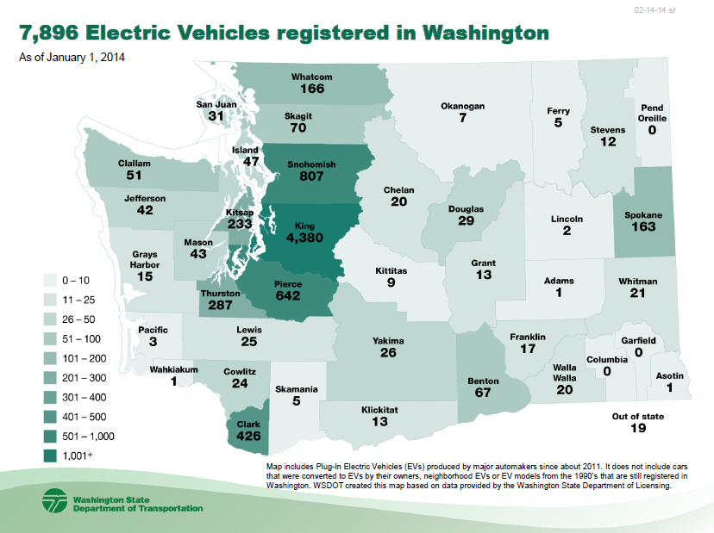
State Embraces Electrification

Slide 19
Act IV
State Action

Slide 20
Cleaner Energy Act
HB 1303 established a statewide 100% alt fuel mandate for state agencies and local governments to the “extent practicable”
State agencies: 40% by June 1, 2013 and 100% by June 1, 2015 (WSDOT obligations subject to available funds)
Local governments: 100% by June 1, 2018
Process to define “practicability” and how agencies will be evaluated in efforts to operate publicly owned vessels, vehicles and construction equipment from electricity or biofuel, “to the extent practicable”

Slide 21
State Agency Rule Development
2013 Work Group: Commerce, WSU Energy Program, WSDOT, Ecology, Agriculture and Enterprise Services
Definitions for various elements
Existing state and federal policies and programs
Data gathering & tracking
Motor pool consolidation
Focus on top tier – the “Sweet 16”
  = 98% of state fuel use

Slide 22
Key Considerations
Criteria and thresholds…
Functional Differences: Equipment and fuels
Duty Cycles: Timelines and lifecycle costs
Fleet Size: Volume of fuel, number of vehicles
Geographic Availability: Infrastructure, seasonality
Program Implementation: Administrative cost, integration
Phased Approach: Different fuel applications or quantities

Slide 23
It is Considered Practicable…
Biodiesel: it is considered practicable for agencies to
  use a minimum of B20 on an annualized basis when purchasing fuel through the state procurement system
  make good faith efforts to procure a minimum of B20 when purchasing retail fuel
Plug-In Electric Vehicles (sedans and delivery vans):
  due for replacement prior to January 1, 2018
  anticipated range of no more than 60 miles/day
  lifecycle cost within 5% of an equivalent hybrid
Ethanol: already E10; make good faith efforts to procure E85 for flex fuel vehicles
RNG: actively assess opportunities for nat gas vehicles
Other: propane, CNG/LNG, may be substituted if electricity and biofuels are not practicable

Slide 24
Alt Fuel-Vehicle Tech Assistance Group
Quarterly Meetings
Ongoing Support (Commerce, WSU Energy Program, Agriculture and Western Washington Clean Cities)
Local Governments & Trade Associations
Integrated Reporting

Slide 25
Ongoing Technical Assistance
Report to Legislature on early results
New vehicle procurement
“Total cost of ownership” tool
Ride and drive events
Electric vehicle leasing options
Charging infrastructure updates
Biodiesel procurement & pricing

Slide 26
Local Govt Rule Development
Timeline: begin Spring 2014, due June 2015
Work Group: counties, cities, public fleet managers, transit systems, public ports, utilities, and others
First Step: define “local government subdivision”
Ongoing coordination & technical assistance
Existing state and federal policies and programs
Data gathering & tracking
Threshold determination
Compliance expectations
Reporting

Slide 27
Epilogue
What’s Next?

Slide 28
Renewable Natural Gas (RNG)
Western Washington Clean Cities
Market Analysis and Outreach (2011-12)
First “Cash Cow” Symposium (2013)
New markets for biogas from landfills, WWTPs and dairy digesters
A first! Pierce Transit Agreement using RNG from landfill gas
Additional interest – Port of Seattle

Slide 29
Pacific Coast Collaborative

Slide 30
Pacific Coast Collaborative
II. Transition the West Coast to clean modes of transportation and reduce the large share of greenhouse gas emissions from this sector with actions to:
Adopt and maintain low-carbon fuel standards in each jurisdiction
Take actions to expand the use of zero-emission vehicles, aiming for 10 percent of new vehicle purchases in public and private fleets by 2016.

Slide 31
Clean Fuel & ZEV Standards
Authority vs Capacity…with a big dose of politics
Legislature has not adopted either low-carbon or clean fuel standards or zero emission vehicle standards
Administrative authority for the Washington Department of Ecology to act under the state Clean Air Act
However, any capacity to administer new standards would be subject to legislative appropriation
Option: Explore regional market for West Coast

Slide 32
Major Players
Departments of Transportation, Enterprise Services, Commerce, and Agriculture, Western Washington Clean Cities, and WSU-Energy Program
Thank You

Slide 33

Jim Jensen
Senior Bioenergy and Alternative Fuels Specialist
jensenj@energy.wsu.edu

