Slide 1


Electric Vehicles and
Economic Opportunity
Why EVs?
EVs and Charging EV Batteries
Support for EVs
Anne Fritzel, Senior Planner
Growth Management Services
Notes:
This presentation is on the transition for electric vehicles and the opportunities available for individuals, businesses, and communities , and the support provided by state and federal governments.

Slide 2
circa 1919
Notes:
Not really a new technology

Slide 3
2SHB 1481 (2009) Electric Vehicle Bill
Why Support Electric Vehicles?
Electricity prices are stable
Locally produced clean power
Transportation sector largest source of emissions
Create green jobs, support green economy tourism, local EV industry
Notes:
In 2009, the legislature passed Bill SSHB 1481 to support the development of a convenient infrastructure to recharge plug-in electric vehicles as a way to support a rapid transition to electric vehicles.

Slide 4
2SHB 1481 (2009)
Regarding Electric Vehicles
By July 1, 2011, all cities and counties in Washington must allow electric vehicle battery charging facilities as a use in all areas. . . Except for residential or resource zones or critical areas.
RCW 36.70A.695 and other statutes
Notes:
In 2009, the legislature passed Bill SSHB 1481 to support the development of a convenient infrastructure to recharge plug-in electric vehicles as a way to increase commercialization of these vehicles.

Slide 5

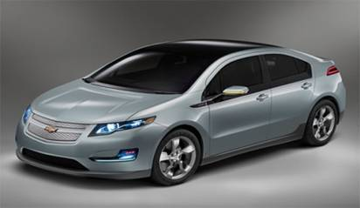
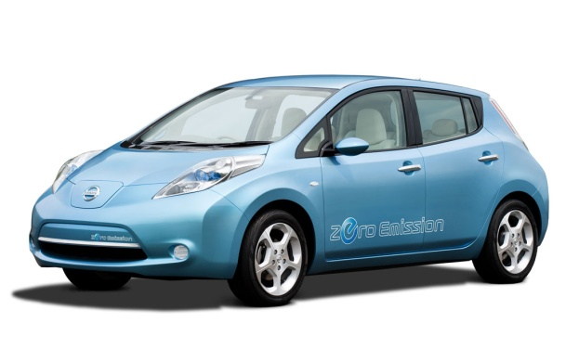
Types of Electric Vehicles
Chevrolet
Nissan LEAF
Chevy Volt
All Electric
Range: 100 miles
Battery: 24 kwh
Priced at $32,780
Target markets:
  Urban Commuters
  Eventually: all-purpose
Battery Electric plus ICE range extender
Range: 10-40 miles all-electric, 200-300 miles gas
Battery: 16 kwh
Priced at $41,000
Target Market: all auto applications
Notes:
Here are the electric cars we have to reach market now. Well except for the supply issue in Japan.
Many more conversions, and NEVs also on the roads.
There are three types of PEVs:
The simplest type is the battery electric vehicle (BEV), which is propelled only by one or more electric motors powered from a battery charged from the grid when the vehicle is stationary.
The second type of PEV is a BEV with a range-extender. Like other BEVs, it is propelled by an electric motor powered by a battery charged from the grid when the vehicle is stationary. The range-extender is a small on-board ICE that drives a generator that can drive the electric motor or charge the battery, or both, when the energy in the battery gained from charging from the grid is depleted.
The third type of PEV is the plug-in hybrid electric vehicle (PHEV), which is propelled by an electric motor or an ICE, or both. It has a battery that can be charged from the grid while the vehicle is stationary, or on-board from a generator powered by the vehicle’s ICE. PHEVs are similar to hybrid vehicles on the road today except for the big difference that their larger batteries that can be charged from the grid.
The batteries in all three types of PEVs can also be charged by what is known as regenerative braking: the energy of motion is transformed into electrical energy, thereby further increasing the efficiency of electric traction.

Slide 6
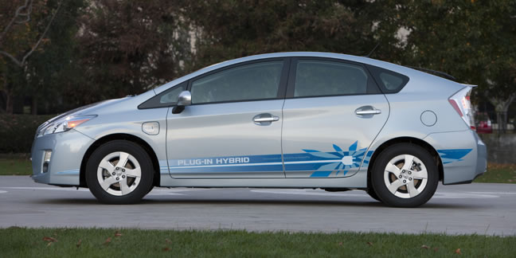
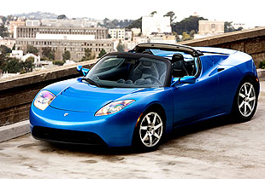
Types of Electric Vehicles
Toyota Prius Plug-in Hybrid
Tesla Roadster
Electric plus gas
13 miles electric only
Price TBD - Available in 2012
Target Market: all auto applications
All Electric
245 miles per charge
Priced at $109,000
Luxury, but Model “S” coming, priced at $50,000.
Notes:
Currently $7500 federal tax credit for individuals and businesses. Good for first 200,000 of each model. With a production run of about 20,000 for these models, should be around for a while.

Slide 7
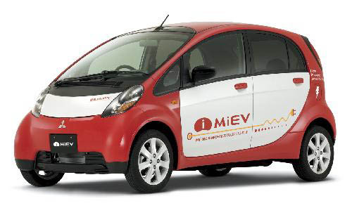
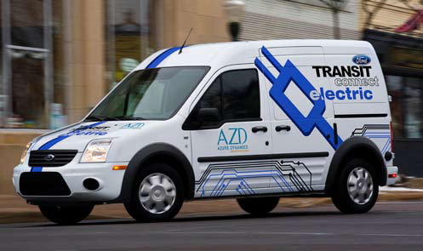
Types of Electric Vehicles
Mitsubishi i-MiEV
Ford Transit Connect Electric
All Electric
Range: 45 - 85 miles,
Priced at $30,000
Target markets:
  Urban Commuters
  Second Car in Every Home
All Electric
Range: 50 - 80 miles
Priced at $50,000
Target markets:
  Commercial uses for delivery or passenger van
Notes:
No tail = no pipe emissions, in fact, no tail pipe.

Slide 8
Nissan LEAF Range and Vehicle Efficiency
Speed and Driving Conditions | Outside Temp (F) | Accessories | Estimated Range (mi) | Vehicle Efficiency (mi/kWh)*
Cruising 38 mph | 68º | None | 138 | 5.75
Fairly steady 24 mph City traffic | 77º | None | 105 | 4.38
Steady 55 mph Highway | 95º | A/C on | 70 | 2.91
Crawling 15 mph Stop-and-go | 14º | Heater on | 62 | 2.60
Average 6 mph Heavy stop-and-go | 86º | A/C on | 47 | 1.96
Nissan LEAF has a 24 kWh battery Source: “Nissan Agrees - EV Mileage Will Vary; Leaf Tests Show 91-Mile Variation.”
Green Car Advisor – edmunds.com. 6-15-10.

Slide 9
EV Fleet Economics
 | Chevy Impala | Nissan Leaf | Chevy Volt
Purchase Price | $22,000 | $32,000 | $ 41,000
Federal Tax incentive |  | $7,500 | $ 7,500
Sales proceeds | $6,500 | $10,000 | $ 12,500
Net Cost (4 years) | $15,500 | $14,500 | $ 21,000
Car Charger |  | $1,000 | $1,000
Maintenance ($500/year) | $ 2,000 | $ 2,000 | $ 2,000
Fuel for 4 years - gasoline | $ 12,000 | $ - | $ 4,140
Fuel for 4 years - electricity | $ - | $ 1,408 | $ 1,126
 | 80 miles/day all gasoline | 80 miles/day all electric | First 40 miles /day electric 40 miles/day gas
NET COST
4 years @ 18,000 miles /year | $ 29,500 | $ 18,908 | $ 29,266
4 years @12,000 miles/year | $ 25,500 | $ 18,439 | $ 27,511
10 years @12,000 miles/year | $ 49,347 | $ 32,377 | $ 46,400
10 years @ 18,000 miles/year | $ 57,000 | $ 32,020 | $ 52,666
Assumptions
18000 miles/year
80 miles/220 days
24 miles/gallon
$4/ gallon gasoline
$.08 kWh electricity
12000 Miles /year
60 miles/220 days
Does not include charger costs.
Notes:
How does this fit with your business needs, your needs as an individual, or a community.

Slide 10
2SHB 1481 Laws of 2009
Regarding Electric Vehicles
By July 1, 2011, all cities and counties must allow electric vehicle battery charging facilities as a use in all areas . . .
Three levels of battery charging facilities.
  Level 1 - 120 volts
  Level 2 - 240 volts
  Level 3 – 480 volts
Notes:
In 2009, the legislature passed Bill SSHB 1481 to support the development of a convenient infrastructure to recharge plug-in electric vehicles as a way to increase commercialization of these vehicles.

Slide 11
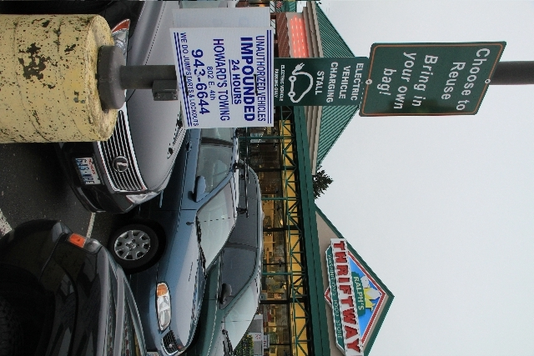
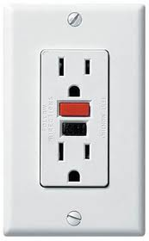
Charging EV Batteries
Level 1
120 V is like any normal GFI outlet
Cost: $12 plus installation
Normally allowed everywhere with electrical permit.
Typical charging time: 16-24 hours
Typical location: home, office.
Notes:
"Battery charging station" is also defined in the bill “an electrical component assembly or cluster of component assemblies designed specifically to charge batteries within electric vehicles, which meet or exceed any standards, codes, and regulations set forth by chapter 19.28 RCW and consistent with rules adopted under RCW 19.27.540.”
We are all familiar with Level 1 outlets – just a GFI outlet at a parking stall, with a sign saying “Electric Vehicle Charging Station”.
Every electric car includes a 110 outlet for when they can not get to any other level charger.
This provides “Opportunistic charging” even at a low level. Great support for business, cheaper than WiFi!

Slide 12
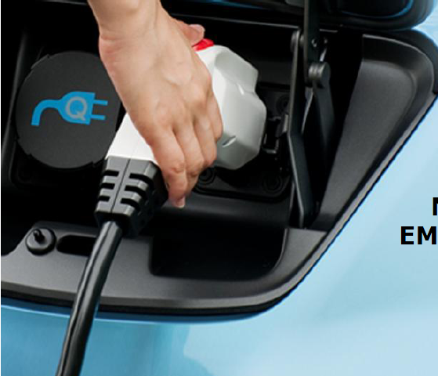
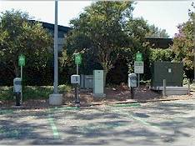

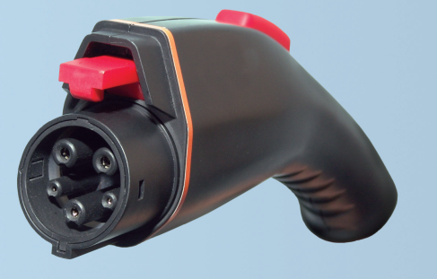
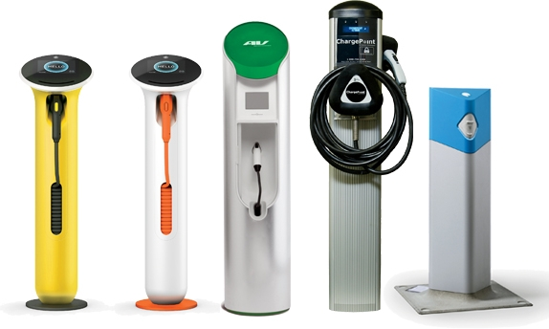
Charging EV Batteries
Level 2
240V like an electric
oven or dryer
Requires dedicated
circuit.
J1772 Plug
$2000 plus installation,
more for credit enabled.
30% tax credit extended to 2011.
Normally allowed in all zones with an electrical permit.
Typical charging time: 4-6 hours
Typical installation: home restaurant, hotel, recreation facility.
Notes:
Level 2 is a little more complex, requires special equipment.
Bill in 2010 legislature to allow charging for charging.
Credit is up to $1000 for individuals.

Slide 13
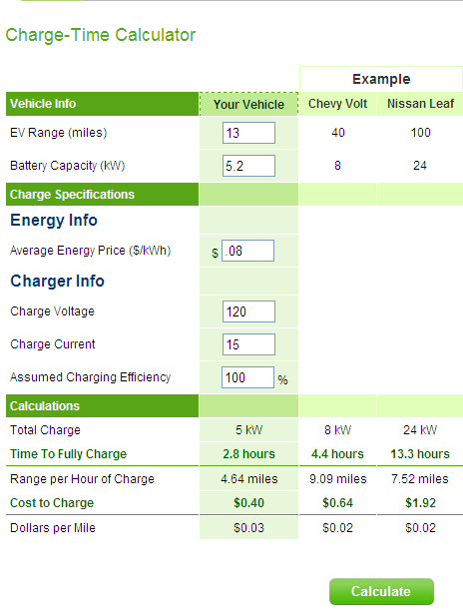
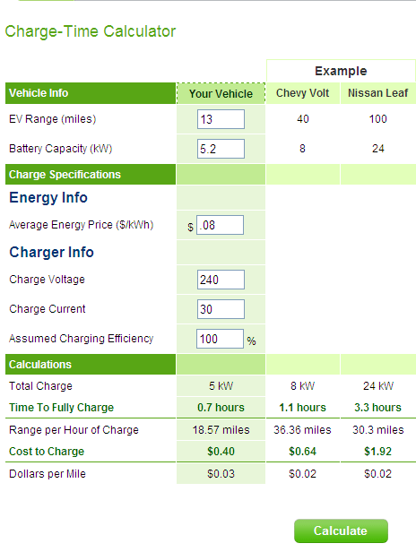
EV Charging Rates
Source: www.leviton.com
Level 1 Charging
Level 2 Charging
Notes:
Notice that the times are vastly different (about factor of 4)
But cost to charge is the same.
Compared to gas: at 30 mpg = $.13 per mile.
Battery pack costs - $.10 per mile for Leaf. $.06 for Volt.

Slide 14
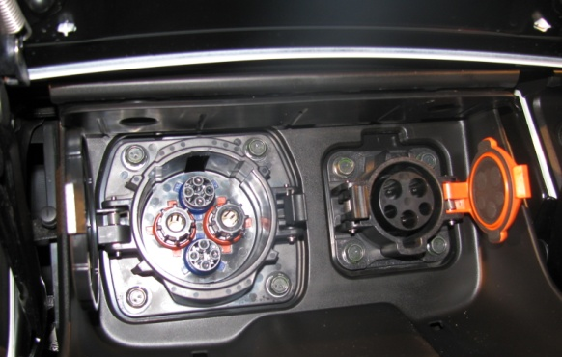
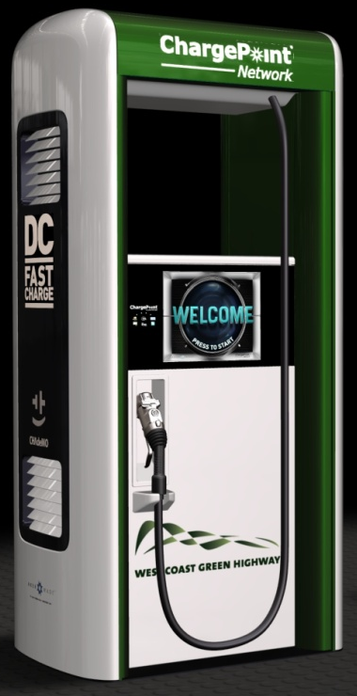
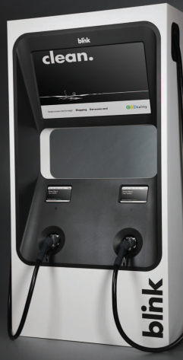
Charging EV Batteries
Level 3
480V like a welder
or commercial refrigeration unit
Typical charging time: 15-30 minutes
Cost: $50,000 plus installation, ensure adequate power from the utility
Normally allowed in commercial and industrial zones with a higher level of review.
Typical locations might be gas stations, high visibility, maximum access
Notes:
Level 3 is specialized equipment, and is also called DC or Fast Charge. It requires 480V, and has the least level of certainty in standardization of the equipment, or certification from the Underwriters Laboratory.

Slide 15
Battery Exchange Stations
Must be allowed along I-5, I-405, I-90, and SR-520.
  citywide for cities adjacent to these highways
  within 1 mile for counties adjacent to these highways
  (RCW 36.70.695)
Batteries stored for exchange (like propane canisters)
$1 million facility
Not currently in the US
Notes:
A battery Exchange Station is required for communities adjacent to I-5, I-405, I-90 and SR 520, and for county lands within 1 mile of these highways. Not currently existing in the US, and may not be practical except for fleet locations. However, we are ready!

Slide 16
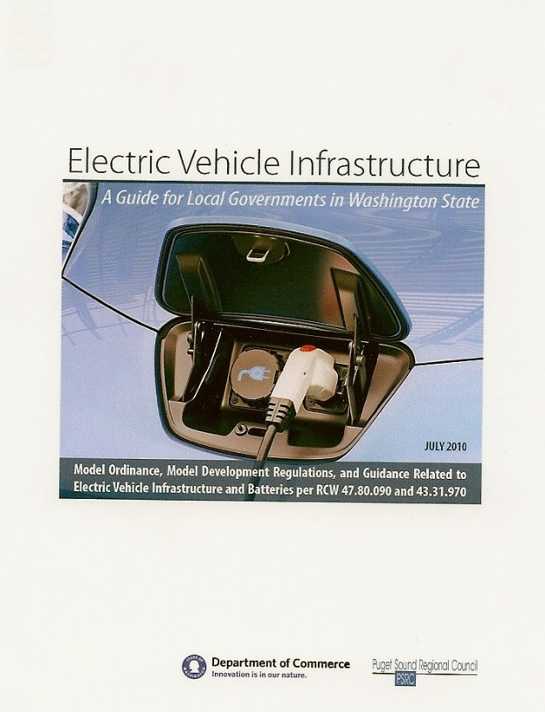
2SHB 1481 Laws of 2009
By July 1, 2011, all cities and counties must allow electric vehicle battery charging facilities as a use in all areas, except for residential, resource, and critical areas.
(RCW 36.70A.695 and other statutes)
  Electric Vehicle Infrastructure
  www.ElectricDrive.wa.gov
Notes:
In 2009, the legislature passed Bill SSHB 1481 to support the development of a convenient infrastructure to recharge plug-in electric vehicles as a way to increase commercialization of these vehicles.

Slide 17
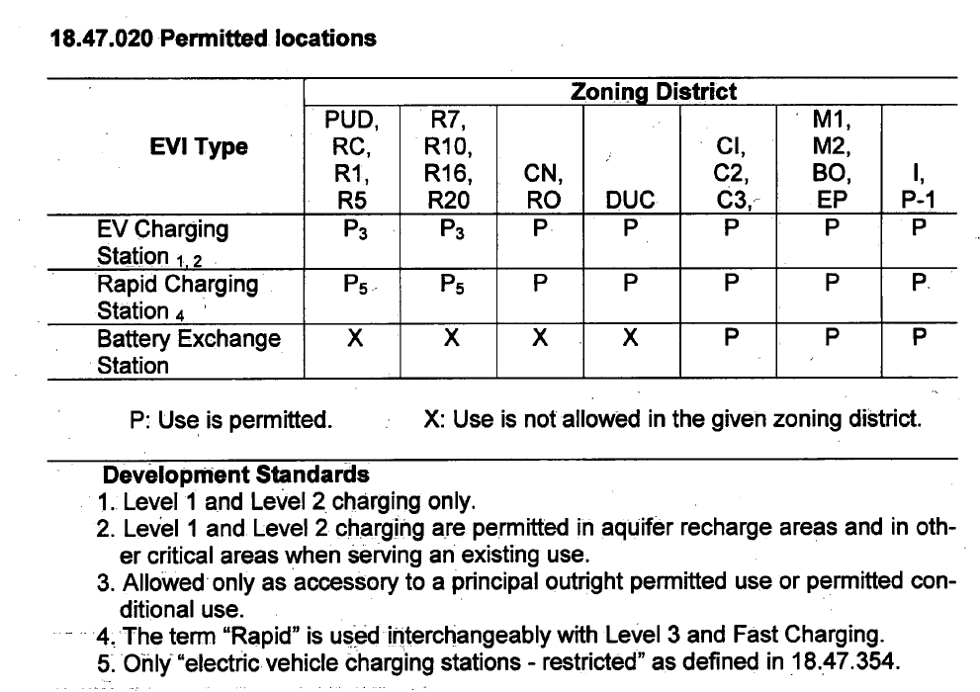
  Zoning
City of Auburn
Ordinance No. 6365, June 20, 2011
Notes:
For Zoning - with examples for ways to allowing EVI. (Tumwater)
Communities do not have to allow EVI in residential, Resource, or critical area zones.
No prohibition. We encourage communities to allow at least level 1 and 2 everywhere.

Slide 18

EV Sign Standards
Encourage property owners to use these signs
Roadways

Slide 19

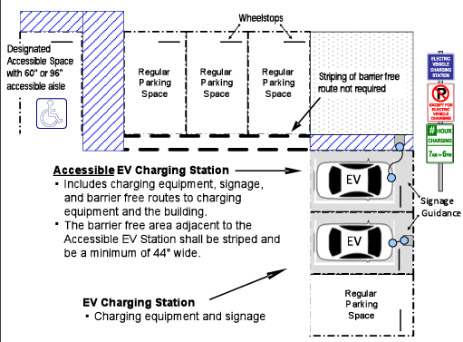
Design Standards
City of East Wenatchee
Ordinance No. 2011-02
Notes:
The model ordinance can give guidance for private and public parking lot design and storage.
For example, the cities of Lacey and East Wenatchee adopted the signage and parking lot design recommendations.
Two types of Signs

Slide 20
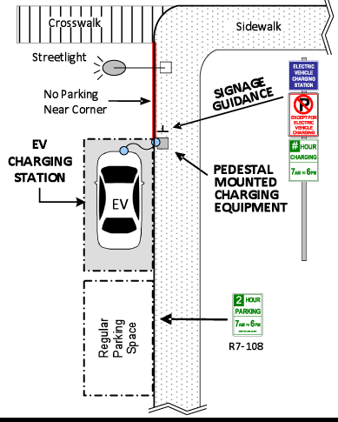
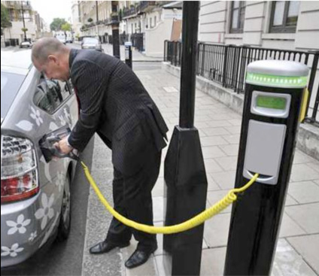
On-Street Charging Stations
City of Tukwila,
Ordinance 9.28.037
  Public Parking
  – Station location
  – Parking enforcement
Notes:
No communities have yet (March 2011) designated public on-street parking spots, though some are designated at city halls (Bellevue and Lacey). However, cities do have enforcement provisions for when spots are designated. (Tukwila)

Slide 21
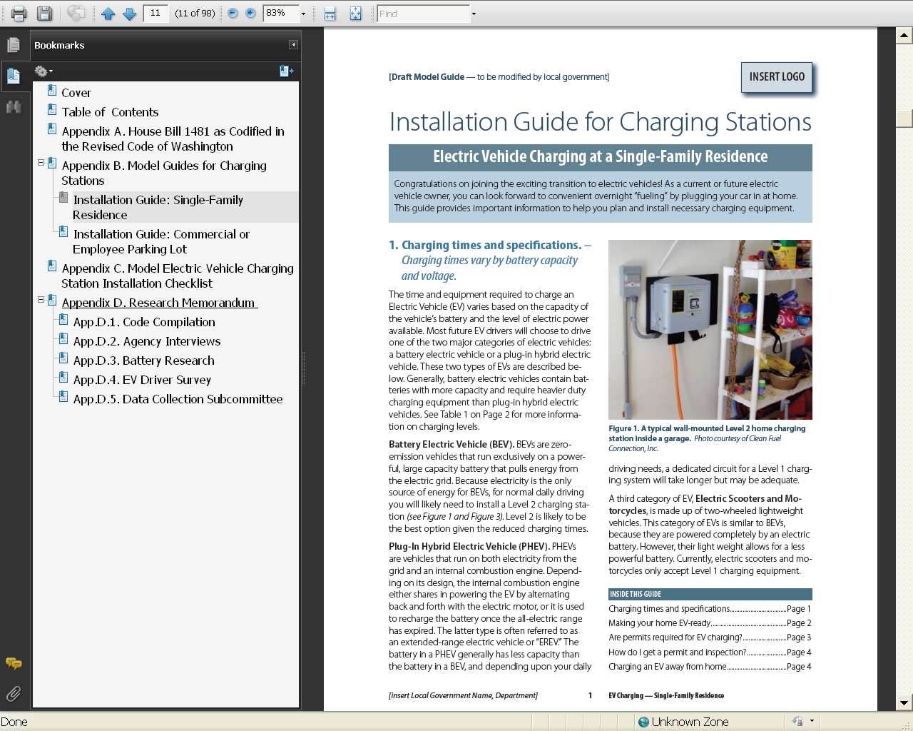
Appendices to Model
Notes:
Appendices include:
The consultant team did a great job of putting together very useful appendices. These include:
Downloadable Installation Guides for Residential or Commercial Charging Stations. There are very informative and can be customized for use at a local permit counter – intended ultimately for local businesses.
Another tool is an example Electric Vehicle Charging Station Installation Checklist - for use as a charger is being permitted and installed.

Slide 22
2SHB 1481 Laws of 2009
State Support for EVs
RCW 82.08.816 – Electric vehicle batteries and infrastructure exempt from retail sales and use tax.
RCW 43.21C.410 – EV Battery charging station installation exempt from SEPA.
RCW 82.29A.125 – State and local governments may lease land for electric vehicle infrastructure, exempt from leasehold tax.
Cities may adopt incentive programs to encourage EVI.
2018 all cities, 100% of fuel from renewable sources
(RCW 43.19.648 - revised from 2015 by HB 1478 - laws of 2011)
Notes:
Ways that the state has tried to find ways to make it easier for businesses, local governments and citizens to get rolling in Evs.
2015 fuel requirements

Slide 23

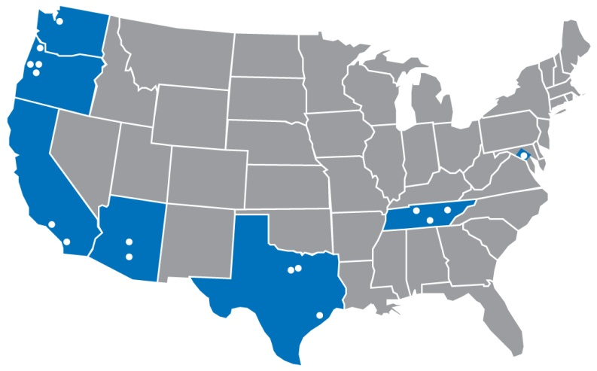
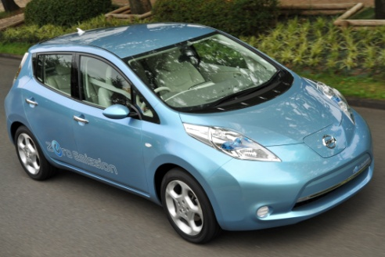
Federal Support for EVs
Federal Investment in Electric Vehicle Charging Infrastructure
The EV Project
ECOtality awarded $20M in U.S. DOE funds to install charging infrastructure in Puget Sound
1,200 public and fleet charging stations, including 22 fast-chargers
1,000 private charging stations for Nissan LEAF owners
Charge America
Charge Northwest/Coloumb awarded $37M to install 5,000 charging stations in 37 regions, including eastern King County (Bellevue).
Cities and Counties
Puget Sound Clean Cities Coalition awarded $15M to install charging stations and purchase fleet vehicles. Other cities used EECBG funds to purchase and install EV chargers.

Slide 24
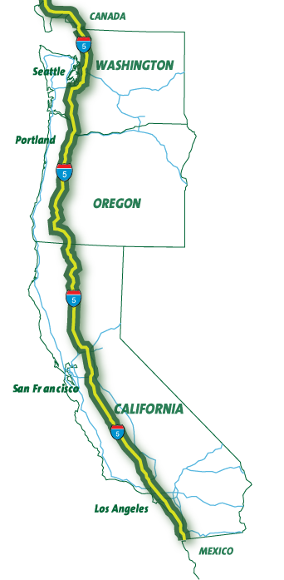

Public/private partnerships to promote sustainable transportation solutions in the I-5 corridor
Provide travelers with alternative fuels, “BC to Baja”
Tri-State initiative (Washington, Oregon, and California) with agreement with BC Province
Partnership with state DOTs, existing businesses and fuel providers, emerging technologies, and travelers
Collaborate with Oregon and California on joint EV infrastructure development, signage, and funding
Components: alliance, business and marketing assistance, branding, fueling and charging stations.

Slide 25
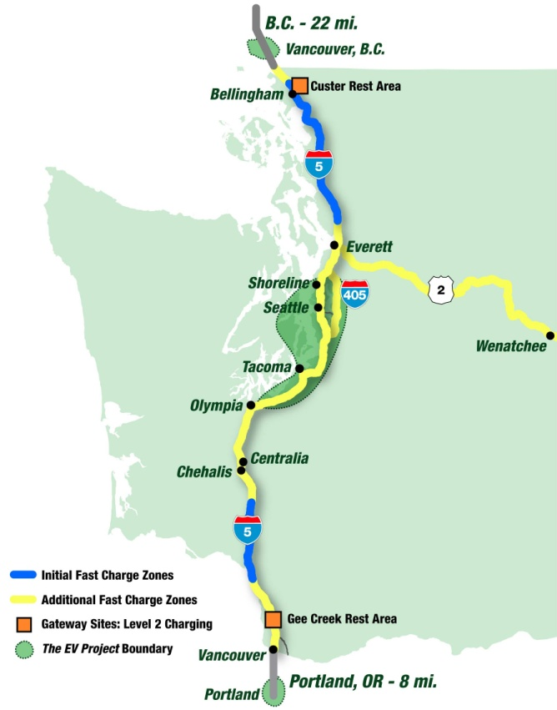

WA Electric Highways
  WSDOT/Commerce Project funded with $1.32M through State Energy Program, US Department of Energy
  Goal: Develop safety net of EV Fast-Charging stations throughout un-served locations along I-5 with additional stations along US 2
  Contract with provider of level 3 chargers. Seek partnerships with retail businesses located in critical recharge zones
  Coordinate EV infrastructure investments with other planned investments in Puget Sound Region

Slide 26
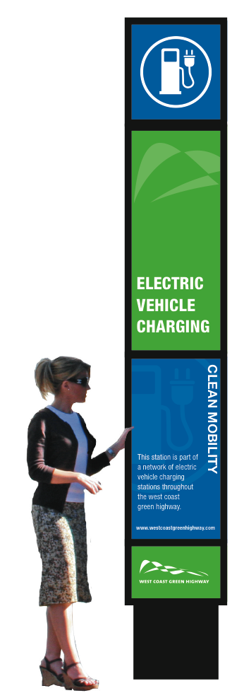
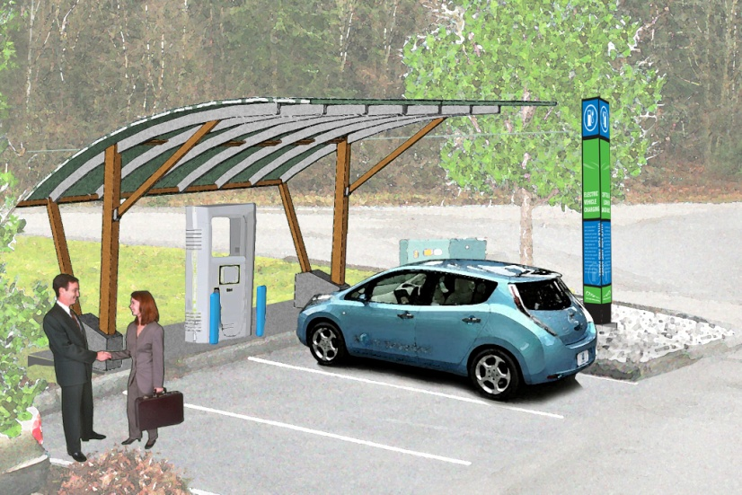
Washington Electric Highways
Host Sites and Retail Partnerships
Selected contractor through competitive process
Identified recharge zones due to distance, etc.
Finalizing locations
Installing EV fast chargers by December 2011
Fast-Charge Site Criteria:
  Within ½ mile of highway interchange
  Safe and convenient access
  Restrooms and drinking water
  Parking space
  Shelter and lighting
  480V 3-phase electric power supply
  Customer amenities (food, traveler info)
  Financial and non-financial contributions

Slide 27

Electric Vehicle Contacts
State Planning Assistance
for Cities and Counties
Anne Fritzel, Senior Planner
Growth Management Services
Washington State Department of Commerce
360-725-3064, anne.fritzel@commerce.wa.gov
www.ElectricDrive.wa.gov
West Coast Green Highway
Tonia Buell, Project Development
and Communications Manager
Public-Private Partnerships Office
Washington State Department of Transportation
360-705-7439, buellt@wsdot.wa.gov
www.westcoastgreenhighway.com/electrichighways.htm
Consumer Resources
www.AmericanGarageMagazine.com
www.PlugInAmerica.org
www.leviton.com

Slide 28
Stop, Shop and Recharge
Car Charging | Level 1 | Level 2
Cost of Charger | $12 | $1,500
"EV Charging Sign" | $40 | $40
Installation | $120 | $200
Tax Credit | 30% of purchase and installation | 30% of purchase and installation
Estimated distance per 2 hour charge | 10 miles | 40 miles
Estimate of cost per 2 hours charge | $0.30 | $1.20
 |  | $0 for Kiosk
Cost per year 3 charges/day/ 250 days/year Assuming 8 cents /kWh | $ 225.00 | $ 900.00

Slide 29
Summary: Types of Electric Vehicles
Make | Price | Battery Type | Electric Range | Charge Time 240 V (120 V) | Charge Time 480 V
Nissan Leaf | $32,780 | 24kWh Lithium-ion | 100 miles | 8 hours (24 hours) | 30 min
Chevy Volt | $41,000 | 16kWh Lithium-ion | 40 miles | 4 hours (10 hours) | N/A
Mitsubishi i-MiEV | $30,000 | 16kWh Lithium-ion | 45-75 miles | 7 hours (16 hours) | 30 min
Ford Transit Connect | $50,000 | 28kWh Lithium-ion | 80 miles | 6-8 hours (24 hours) | N/A
Toyota Prius PI=H | TBD | 5.2kWh Lithium-ion | 13 miles | 1.5 hours ( 5hours) | N/A
Tesla Roadster | $109,000 | 56kWh Lithium-ion | 245 miles | 6 hours | N/A
Notes:
Note that the cost of the car includes about $500/kwh for the battery pack.

Slide 30
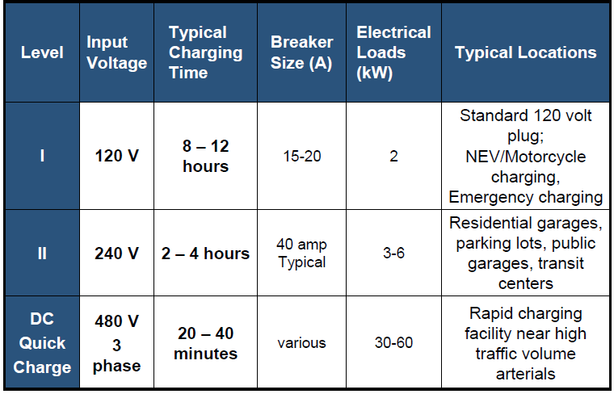
Charging EV Batteries Summary

